Slide 1




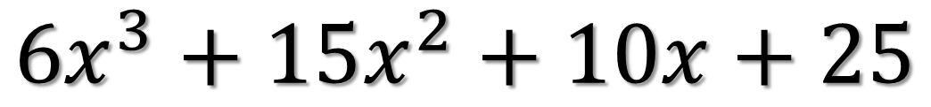


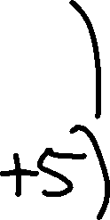
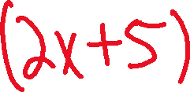


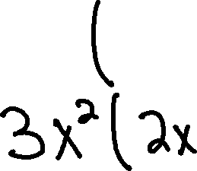

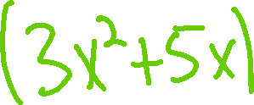
PDN
Find The Error:
$${6x}^{3}+15x^{2}+10x+25$$

Slide 2

FACTORING TRINOMIALS
A $≠$ 1

Slide 3
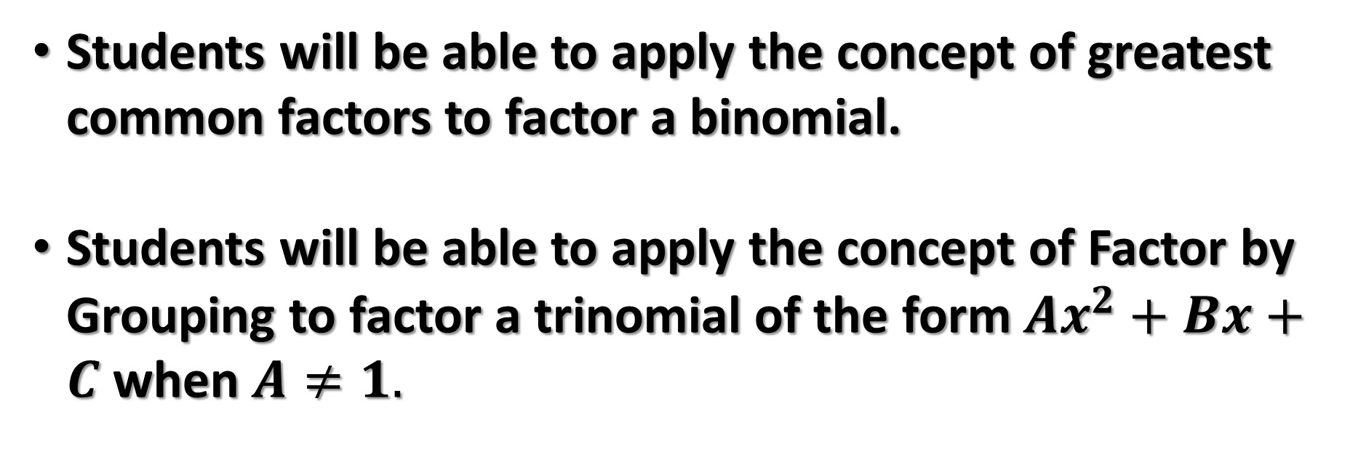
Students will be able to apply the concept of greatest common factors to factor a binomial.
Students will be able to apply the concept of Factor by Grouping to factor a trinomial of the form $Ax^{2}+Bx+C$ when $A≠1.$
Objectives

Slide 4
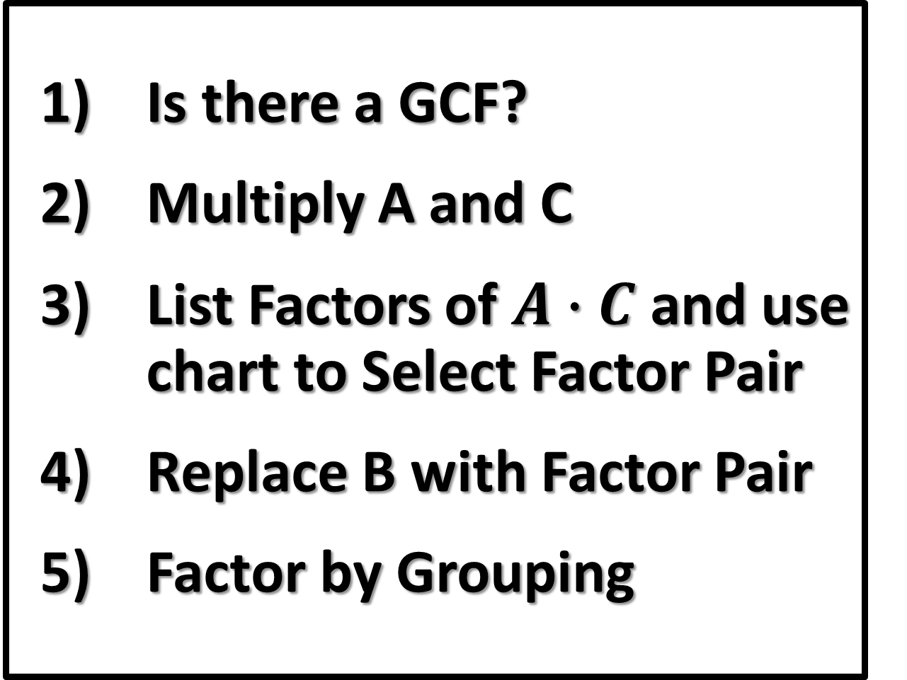

Factoring a Trinomial
$${Ax}^{2}+Bx+C$$
  Is there a GCF?
  Multiply A and C
  List Factors of $A∙C$ and use chart to Select Factor Pair
  Replace B with Factor Pair
  Factor by Grouping

Slide 5
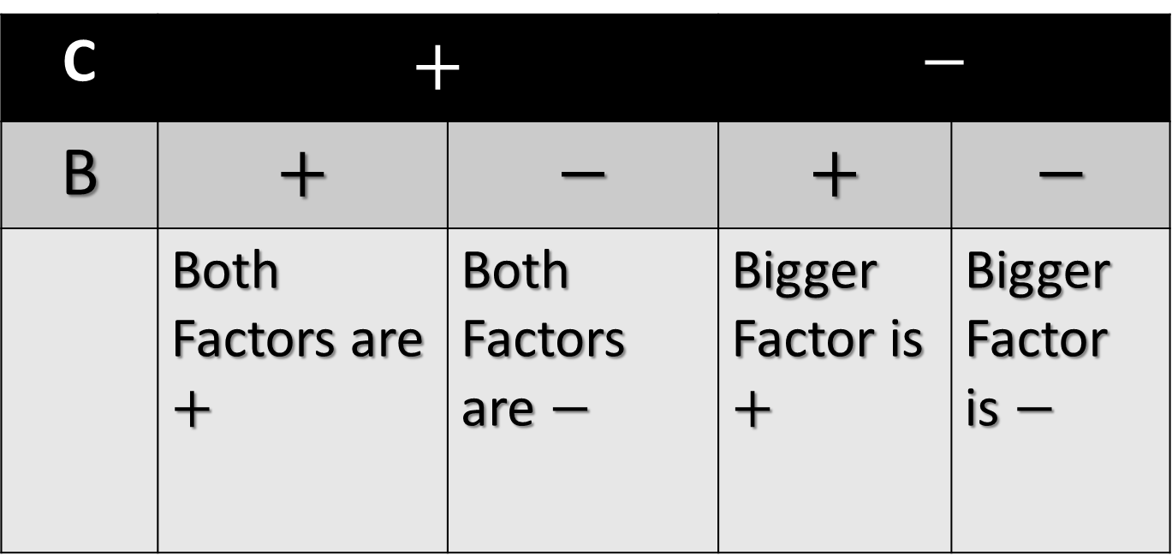
SIGN CHART
C | $$+$$ |  | $$−$$
B | $$+$$ | $$−$$ | $$+$$ | $$−$$
 | Both Factors are $+$ | Both Factors are $−$ | Bigger Factor is $+$ | Bigger Factor is $−$

Slide 6
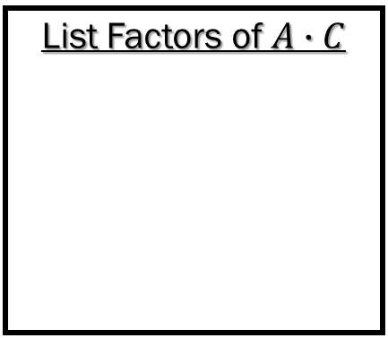

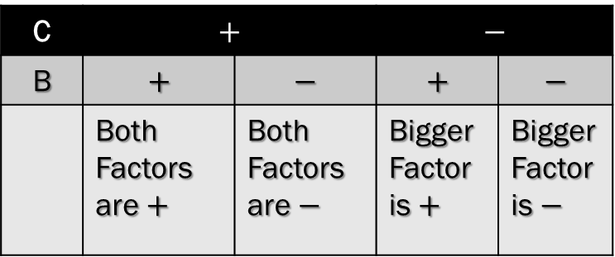
Factoring Trinomials of the Form ${Ax}^{2}+Bx+C$
Trinomial to Factor
A VALUE
B VALUE
C VALUE
Is there a GCF?
Trinomial with GCF Factored Out
MULTIPLY A & C
C | $$+$$ |  | $$−$$
B | $$+$$ | $$−$$ | $$+$$ | $$−$$
 | Both Factors are $+$ | Both Factors are $−$ | Bigger Factor is $+$ | Bigger Factor is $−$
Use the Chart to Find the Factor Pair that Combines to B.
List Factors of $A∙C$
Replace B with Factor Pair
Factor By Grouping
Factored Polynomial

Slide 7
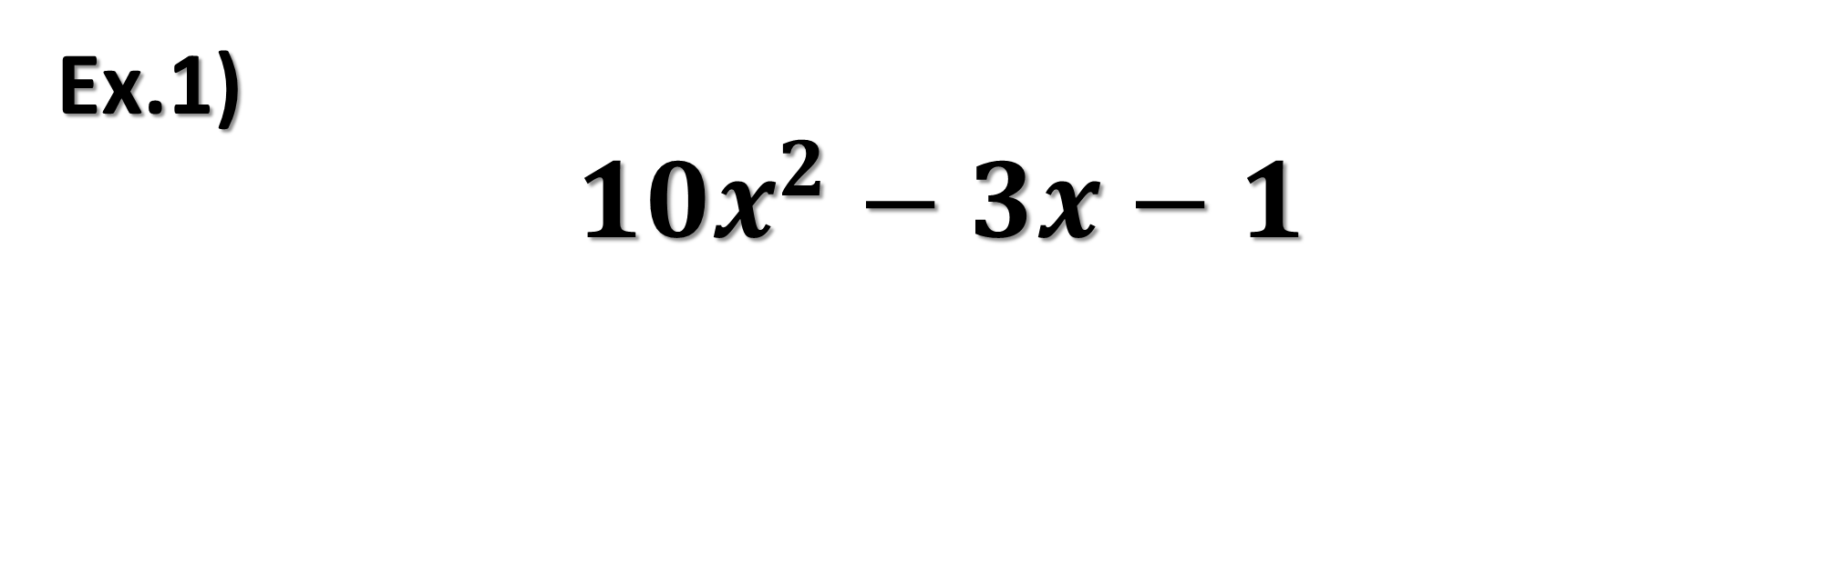
Ex.1)
$${10x}^{2}−3x−1$$

Slide 8


Factoring Trinomials of the Form ${Ax}^{2}+Bx+C$
Trinomial to Factor
A VALUE
B VALUE
C VALUE
$${10x}^{2}−3x−1$$
Is there a GCF?
Trinomial with GCF Factored Out
MULTIPLY A & C
$${10x}^{2}−3x−1$$
C | $$+$$ |  | $$−$$
B | $$+$$ | $$−$$ | $$+$$ | $$−$$
 | Both Factors are $+$ | Both Factors are $−$ | Bigger Factor is $+$ | Bigger Factor is $−$
Use the Chart to Find the Factor Pair that Combines to B.
List Factors of $A∙C$
Replace B with Factor Pair
Factor By Grouping
Factored Polynomial

Slide 9
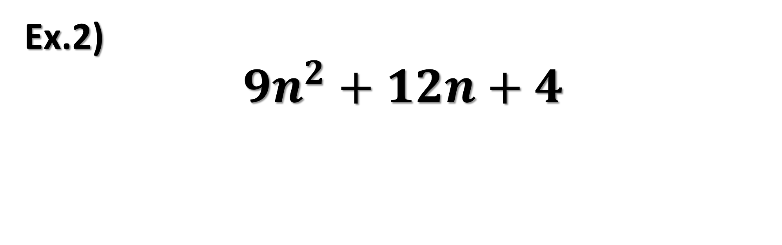
Ex.2)
$${9n}^{2}+12n+4$$

Slide 10
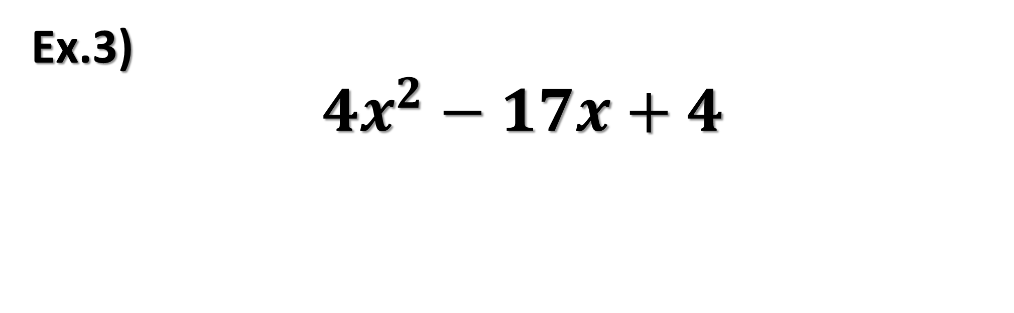
Ex.3)
$${4x}^{2}−17x+4$$

Slide 11
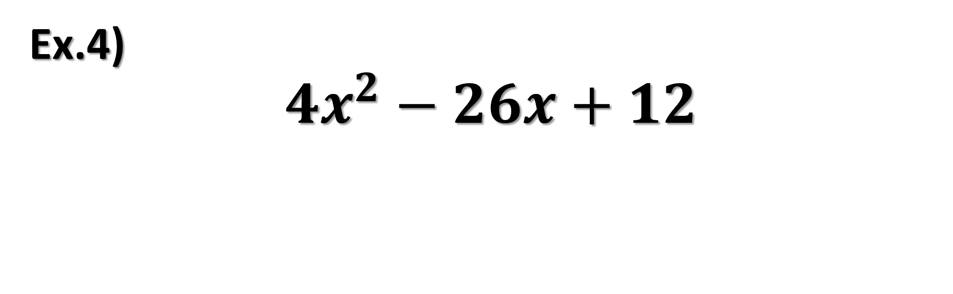
Ex.4)
$${4x}^{2}−26x+12$$

Slide 12


Try These
$${4x}^{2}+12x−7$$
$${4x}^{2}+9x−9$$

Slide 13
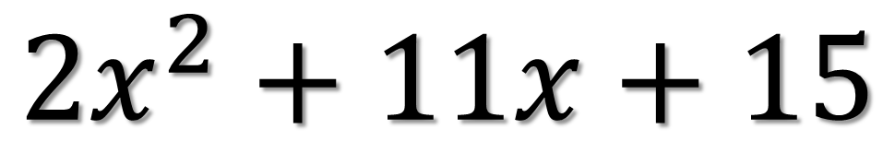
Ticket Out the Door
$${2x}^{2}+11x+15$$
Rate yourself +, -, or o.

